Slide 1
Week 1
What is Data Engineering
ISTA 322 - Data Engineering

Slide 2
What is Data Engineering?
“Data” engineers design and build pipelines that transform and transport data into a format wherein, by the time it reaches the Data Scientists or other end users, it is in a highly usable state. ref
data engineers are concerned with the production readiness of that data and all that comes with it: formats, scaling, resilience, security, and more. ref
they build pipelines that transform that data into formats that data scientists can use. ref

Slide 3
What is Data Engineering?
“Data” engineers design and build pipelines that transform and transport data into a format wherein, by the time it reaches the Data Scientists or other end users, it is in a highly usable state. ref
data engineers are concerned with the production readiness of that data and all that comes with it: formats, scaling, resilience, security, and more. ref
they build pipelines that transform that data into formats that data scientists can use. ref
General definition - Building pipelines to make data useful for data scientists and analysts

Slide 4
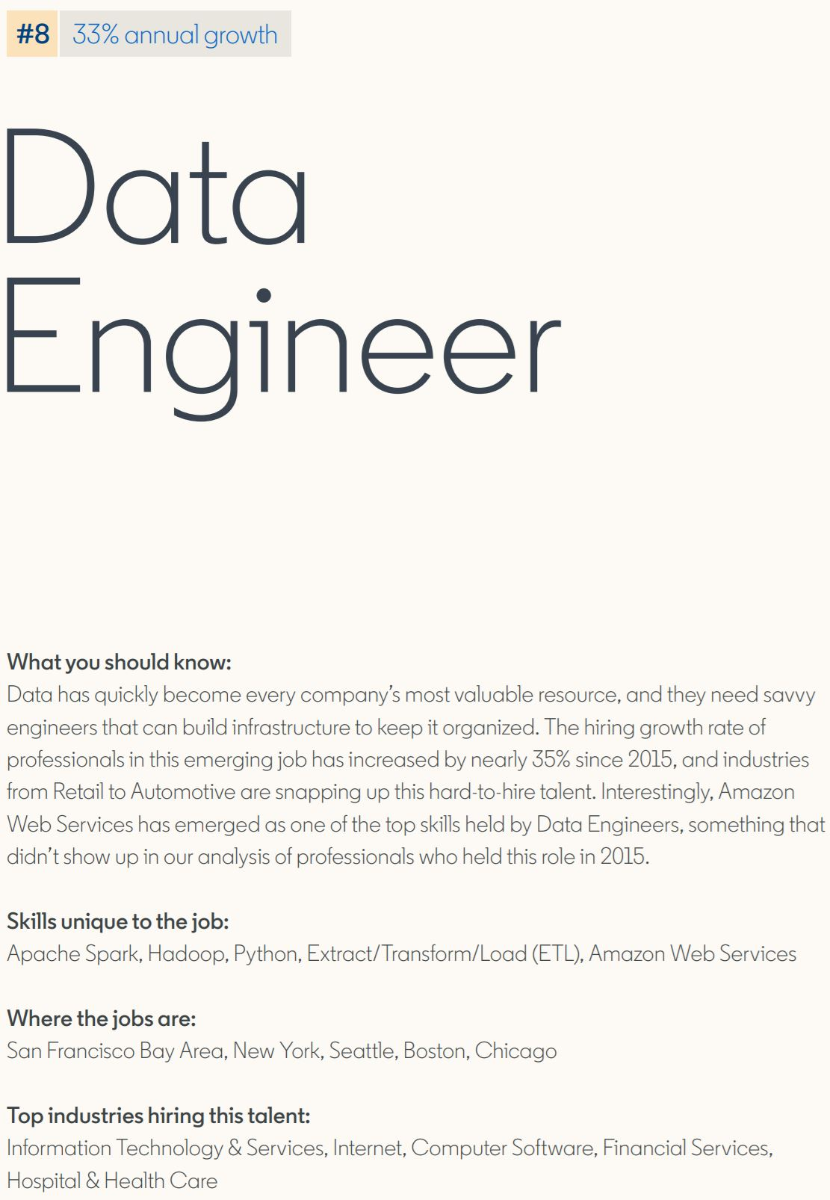
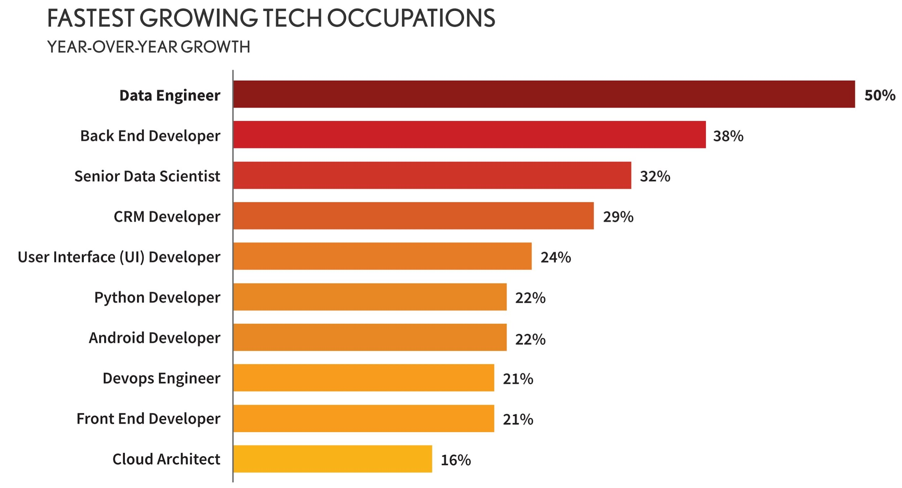
DE jobs are booming
Ref - Dice Tech Jobs Report
Ref - LinkedIn Jobs Report

Slide 5
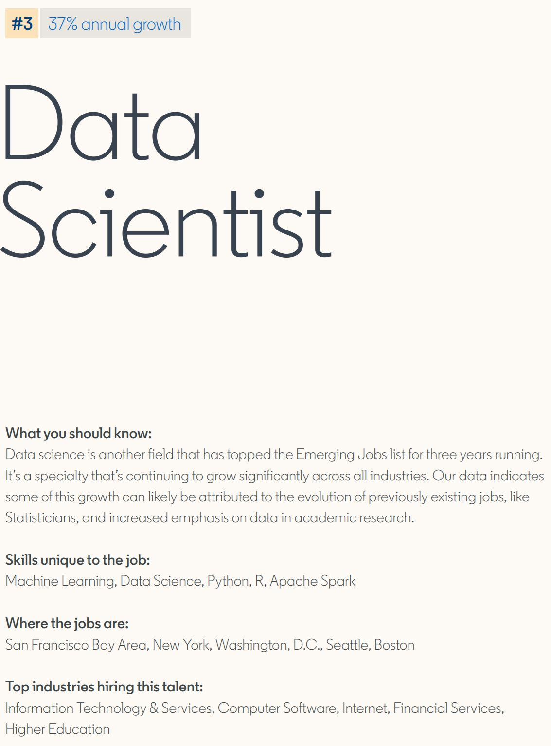
But why though?
Ref - Dice Tech Jobs Report
Ref - LinkedIn Jobs Report

Slide 6

But why though?
Prof’s Note - Lol
Ref

Slide 7
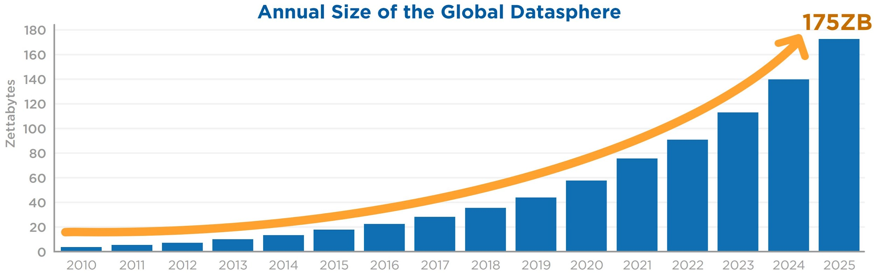
Stepping back to big data
“Sexy data scientists” came about in 2012
Although the job without title has been around for a while
But the field of data science promised big things
And companies had lots of data
1 Zetabyte is
- 350 trillion
songs
- 100k copies
of wikipedia
Ref - Seagate DataAge 2020 Report

Slide 8
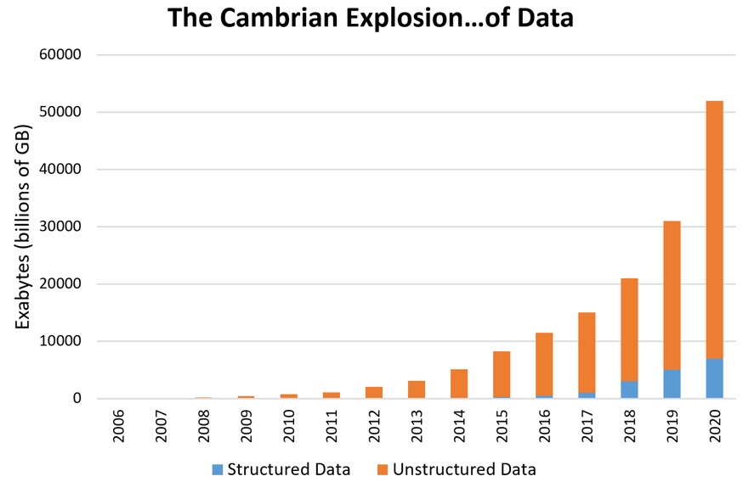
Stepping back to big data
The boom is in Unstructured data
What’s the difference?

Slide 9
Pyramid of data organization
Better to think of structure as being continuous
Less and less data is Structured
More and more is Unstructured
Still room in between
Unstructured data
Semi-structured data
Data amount and growth
Structured data

Slide 10
Pyramid of data organization
Structured data
Fits into a database nicely
‘square’ or ‘cube’ formats
Don’t need to do work to analyze or query
Unstructured data
Semi-structured data
Data amount and growth
Structured data

Slide 11
Pyramid of data organization
TABLE ID: STORE
store_id | store_state | country
az_23 | AZ | USA
az_45 | AZ | USA
ca_12 | CA | USA
to_39 | Ontario | Canada
Structured data
SQL DB with two tables
Simple query to get total sales for AZ stores
No data processing needed to do this
TABLE ID: TRANSACTIONS
transact_id | store_id | UPC | price
x88943 | az_23 | 49914 | 2.57
x88943 | az_23 | 99371 | 1.99
a85921 | to_39 | 95831 | 8.99
a85921 | to_39 | 99492 | 5.49
a85921 | to_39 | 27482 | 4.49
z88930 | az_45 | 33491 | 0.99

Slide 12
Pyramid of data organization
Semi-structured data
JSON, XML, csv, tsv
Has some consistent format
Minimal work to get into useable format
Unstructured data
Semi-structured data
Data amount and growth
Structured data

Slide 13
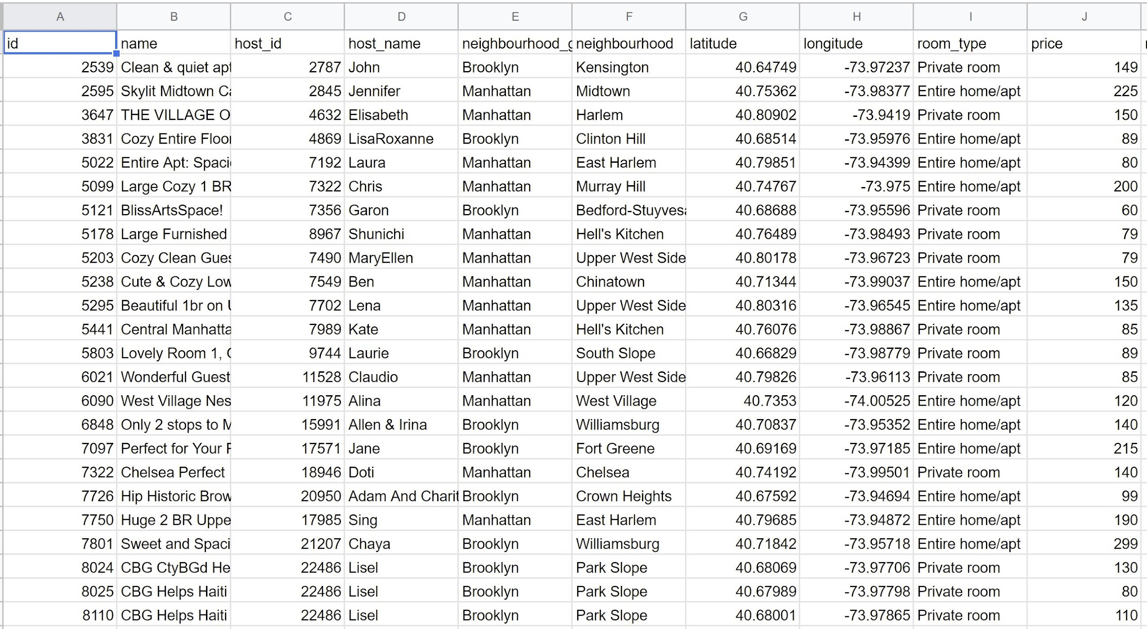
Pyramid of data organization
Semi-structured data
Excel, csv, tsv
May need to clean
Need to join a bunch
Aggregate
May take time, but relatively simple
Sample AirBNB data from CSV file

Slide 14
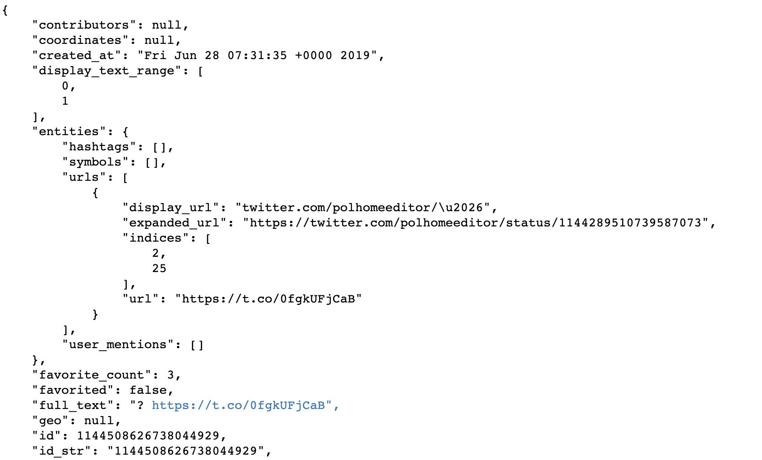
Pyramid of data organization
Semi-structured data
JSON, xml
Has an overall schema/organization
Need to parse and organize to make useable
May take time, but relatively simple
Sample Twitter data in JSON format

Slide 15
Pyramid of data organization
Unstructured data
Text, pdf, images, video
Zero structure
Lots of work to extract useful data from
Unstructured data
Semi-structured data
Data amount and growth
Structured data

Slide 16
Pyramid of data organization
Sample of Twitter text
Unstructured data
Raw text - tweets, facebook, reviews
How do you get something useful?
Lots of processing
Need to understand language
Specific to use case
Unstructured data
## [1] "If you are feeling the impacts of climate change in your daily life, you're not alone. What do you want to protect from #climatechange? Tell us below. #AdaptOurWorld https://t.co/RFyNFRLHGB"
## [2] "Tree 🌲 planting is great but it cannot become a PR machine for fake climate initiatives by the governments. We will not push #climatechange back by planting trees. Governments must listen and act. Real-meaningful actions. Not PR!"
## [3] "Cigarette smokers &amp; vapers are exhaling additional CO2 into the air. I call on all politicians to stop smoking and ban cigarettes and vaping for the earth. If not, then shut up about #climatechange and CO2.\n\nLet’s see how much politicians care about the things they talk about. https://t.co/0v60pNd38q"
## [4] "@ThemeParkReview @Starbucks Make your own coffee. You can even buy the Starbucks brand in a grocery store, if it’s that important. This really is a ridiculous tantrum over something with many solutions. There are better things to worry about like the #ClimateChange that keeps causing these hurricanes."
## [5] "@GaryCMeleJr @DebraMessing The two party system isn’t working for the people &amp; #Democrats need to do better because my independent vote is on loan to them. But it’s the #GOP breaking constitutional norms, refusing to protect our elections, shoving church into state, denying #ClimateChange, caging kids etc"
## [6] "Why are #hurricanes getting bigger and moving slower? 🌪\n\n#HurricaneDorian \n#ClimateChange #ClimateChangeIsReal \n#ThereIsNoPlanetB 🌎 https://t.co/2z1JlpVnUg"

Slide 17
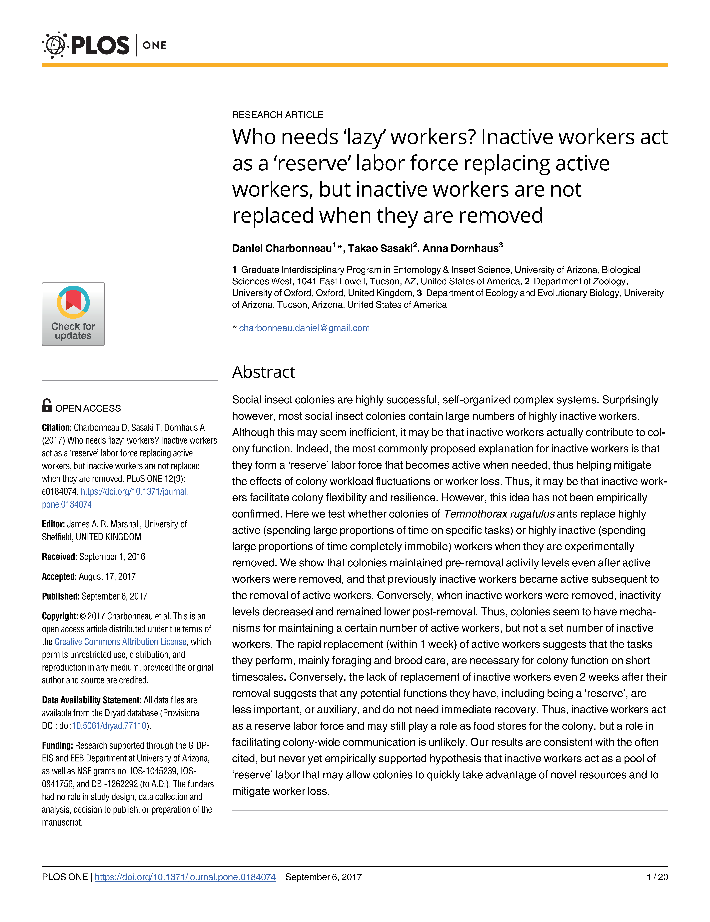
Pyramid of data organization
Sample of journal text
Unstructured data
pdf files
Very long format
Might want to synthesize 1000’s of medical papers to determine effect
Formats vary across journals
Unstructured data

Slide 18

Pyramid of data organization
Image of me and on a motorcycle ride that I posted on Instagram
Unstructured data
Images
Obviously we can determine elements in a picture
Lots of work to get a computer to figure that out
What items are in it
Dan, people, motorcycle, helmet, sunglasses, road, mountain, desert, etc.
Unstructured data

Slide 19
Why is this talk about data structure relevant?
Let’s think about what a data analyst/scientist does
Data Analyst: Processes and analyzes data with the goal of supporting decision making.
Data Science: Extracting useful information from data using computational methods.
Rough definitions, but both are using data to create understanding. Analysts do more whole data aggregation, summaries, basic stats. Data Scientists often delve deeper into stats and machine learning.
Either way, let’s consider the structure of a common model used by both.

Slide 20
Extracting info from data
Let’s say you want to predict if someone shopping on amazon will buy a iPhone
This is a common classification problem.
Target - Will they purchase
Features - Age, income level, browser, searched for iPhone, etc
This is an easy model to fit in R/Python and created a prediction with.
P(buy_iPhone) ~ age + income_level + browser + search_iPhone
But, what format do the data need to be in to run this model?

Slide 21
Extracting info from data
P(buy_iPhone) ~ age + income_level + browser + search_iPhone
Not hard to get data in this format through SQL queries
But what if these are scattered across messy databases
Or say information is in JSON files
buy | age | income | browser | search_iPhone
yes | 32 | 123000 | safari | yes
no | 56 | 56000 | chrome | no
no | 47 | 75000 | firefox | no
yes | 21 | 36000 | safari | yes

Slide 22
Extracting info from data
P(buy_iPhone) ~ age + income_level + browser + search_iPhone + apple_reviews + apple_sent
Not hard to get data in this format through SQL queries
But what if these are scattered across messy databases
Or say information is in JSON files
Or you want features that are from unstructured data sources
Or your data has lots of errors
buy | age | income | browser | search_iPhone | apple_revs | apple_sentiment
yes | 32 | 123000 | safari | yes | 3 | 4
no | 56 | 56000 | chrome | no | 0 | 0
no | 47 | 75000 | firefox | no | 1 | 2
yes | 21 | 36000 | safari | yes | 5 | 5

Slide 23
Data science promised big things using these methods
Predict things - supervised
Click an ad, is a purchase fraud, who you should friend, driving time, shipping time, what posts you should see, etc etc etc
Uncover hidden insights - unsupervised
Customer segmentation, anomaly detection, market basket, etc
Essentially, all things that would (and very much do) make money. Lots of money.
Very cool models and tools to do all this
Regression, logistic regression, SVM, XGBoost, Decision Trees, naive Bayes, knn, k-means, dbscan, hierarchical clustering, PCA, t-SNE, etc
Tableau, PowerBI, Looker, Qlikview

Slide 24
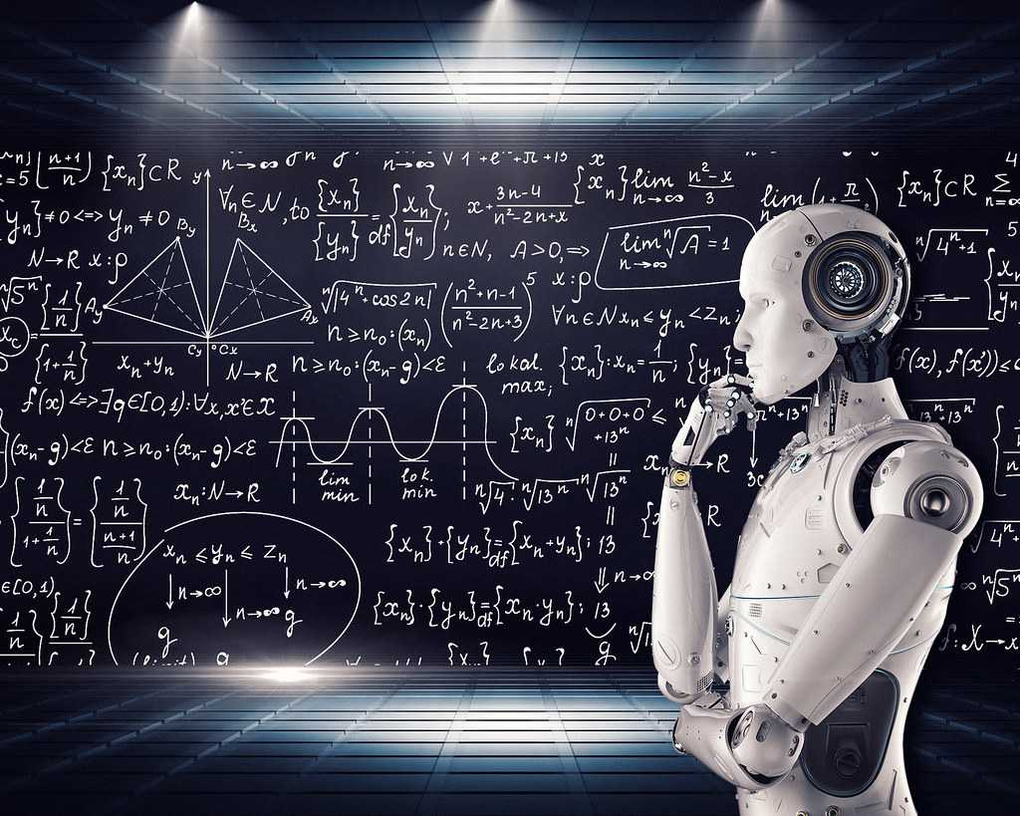

Lots of hype was had
Tons of media about data being the future implying it can do anything
Sexiest job title
Terrible graphics - ohhhhhh
‘Oh so you do code?’
Quote - my aunt
Data science boomed, and everyone wanted these results
But…

Slide 25
When hype meets reality
So what’s the problem with implementing these models or using those tools?
Virtually all of the models follow this structure
Target ~ feature_1 + feature_2 + feature_3 + … + feature_n
This is just a n x m matrix of your target and features
And the tools need a structured DB format
Easy if your data is already structured

Slide 26
When hype meets reality
So what’s the problem with implementing these models or using those tools?
Virtually all of the models follow this structure
Target ~ feature_1 + feature_2 + feature_3 + … + feature_n
This is just a n x m matrix of your target and features
And the tools need a structured DB format
Easy if your data is already structured
Oh, and there’s TONS of it
Too much to even process locally

Slide 27
When hype meets reality
Companies hired people that could use the data
But those people didn’t have access to it!
It was messy, undocumented, in various databases, unstructured, missing, etc etc etc
Early data scientists wound up also having to work really hard to get the data
Extract it from various sources
Clean, manipulate, aggregate, etc… transform it into something useful
Load it somewhere to be used by those fancy fancy models

Slide 28
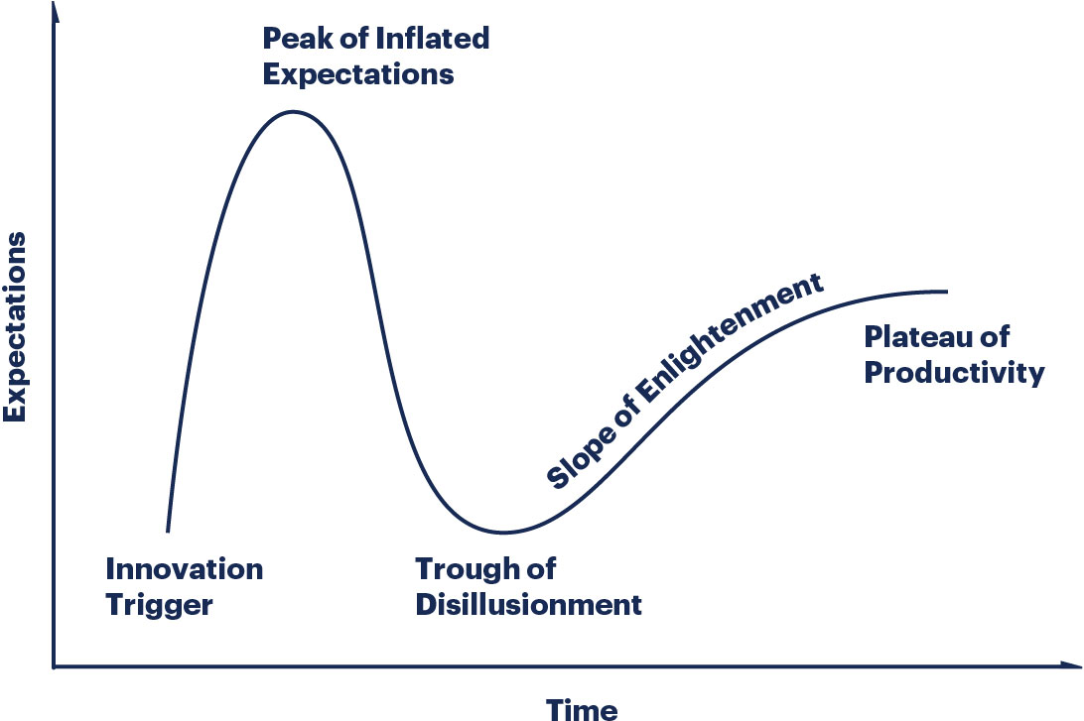
When hype meets reality
This caused problems
‘We hired you, where are my results?’
‘Well, it was 1yr of DE work before I could run a regression’
‘Well, need to spend lots of money to even be able to process our raw data’
Ref - Gartner hype cycle

Slide 29
The reports of my death are greatly exaggerated
In come the data engineers!
Hiring people explicitly to do data engineering
Data science by and large can’t be done without data engineering
Ref - Gartner hype cycle

Slide 30
Pyramid of needs
AI,
deep
learning
Model, understand, learn
A/B tests, ML,
statistics
Aggregate and label
Analytics, aggregates,
basic metrics, features
Transforming and understanding
Data cleaning,
more etl, prep
Moving and storing
Data flow, ETL, structured and unstructured data stores
Collection
User generated data, sensor data, logging, instrumentation
Fig adapted from - Ref

Slide 31
Pyramid of needs
All this cool AI, DS, Business Intelligence work…
AI,
deep
learning
Can’t be done without this data engineering work!
Model, understand, learn
A/B tests, ML,
statistics
Aggregate and label
Analytics, aggregates,
basic metrics, features
Transforming and understanding
Data cleaning,
more etl, prep
Moving and storing
Data flow, ETL, structured and unstructured data stores
Collection
User generated data, sensor data, logging, instrumentation
Fig adapted from - Ref

Slide 32
Data engineering is foundational to data science
Data engineers take the raw data that’s stored and coming in from all over the place and transform it to a useful format
Data scientists take this data and make inference from it
Ideally they work hand and hand
DS knows what the models need, DE knows how to get those data
Industry hiring is following the pyramid
Linkedin DS job search in Phoenix on 08/17/2020 = 204 jobs
Linkedin DE job search in Phoenix on 08/17/2020 = 347 jobs

Slide 33
So what’s a data engineering again?
Should be clear why we need data engineering
Next lecture dive deeper into
Where data comes from - bottom of the pyramid
What tasks DEs do to make it useful - next two levels of pyramid
Read Hammerbacher 2009 - Rise of the Data Scientist
Great story of a DS/DE who helped build the early data infrastructure of Facebook
Read Rogati 2017 - The AI Hierarchy of Needs
Short but good blog post on why DE is fundamental

